Slide 1
Amphidrome ®

Slide 2
Amphidrome® System Benefits
Highest Level of Nitrogen Removal of any system available
Low Visual Impact
Small Foot Print
Media is submerged in liquid - nitrification reaction unaffected by air temperature
All effluent filtered through deep sand bed

Slide 3
Amphidrome® Process
Biological Nutrient Removal (BNR) Process
TSS
BOD₅
Total Nitrogen
Oil and grease
One reactor
BAF Biologically Active Filter
Functions as a Submerged Attached Growth Bioreactor (SAGB) operating in sequencing batch mode

Slide 4
SAGB
Media is submerged in liquid acting as both growth media and filter.
Fine media provides higher concentration of biological growth for enhanced loading capacity.
Media acts as a physical filter
low effluent TSS.
Underground reactor and submerged media performs well in cold weather

Slide 5
Process Description
Main reactor designed to achieve
BOD₅ and nitrogen removal
solids separation
Intermittent aeration
Plus reactor
Enhanced denitrification
Phosphorus removal by chemical addition and filtration (optional)

Slide 6
Process Description
Batch is cycled through the reactor
Treatment varies between aerobic to anoxic
Nitrification and denitrification in a single reactor

Slide 7
Anoxic/Equalization Tank
Solids settling
Sludge storage
Secondary functions
Buffers the dissolved oxygen in the recycled flow
Mixes recycle with influent organic carbon to promote de-nitrification

Slide 8
Main Reactor Function
Media provides surface area for biofilm growth
Provides solids separation eliminating the need for downstream clarification
Intermittent aeration
typical 3 minutes on 15 minutes off

Slide 9
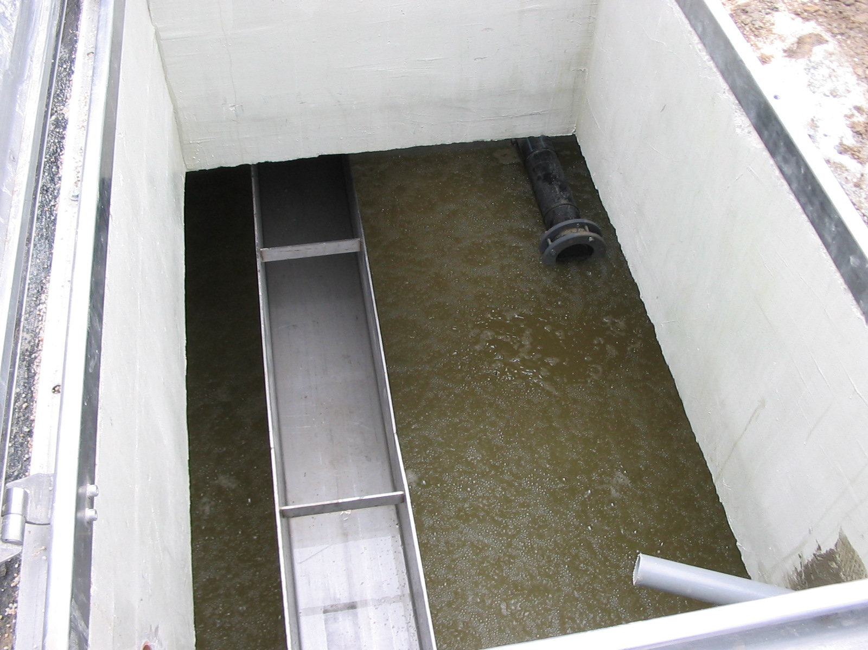
REACTOR UNDER AERATION

Slide 10
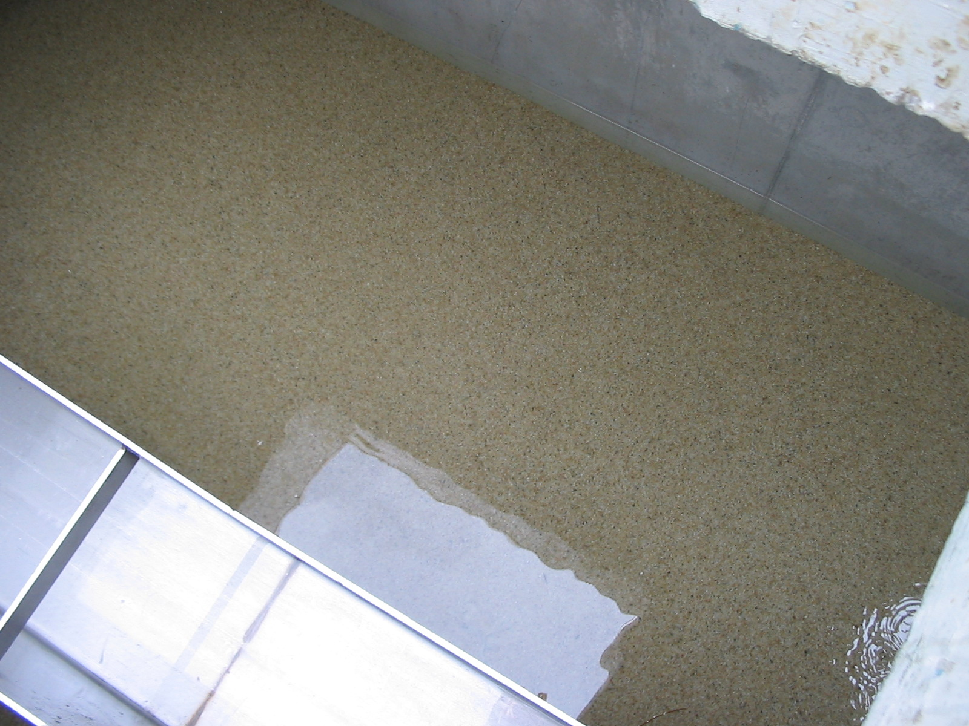
REACTOR IN “AIR OFF” MODE

Slide 11
Clearwell Function
Stores batch volume
Stores some fraction of backwash volume
Contains backwash and effluent pumps

Slide 12
Amphidrome™plus
Polishing denitrification filter

Slide 13
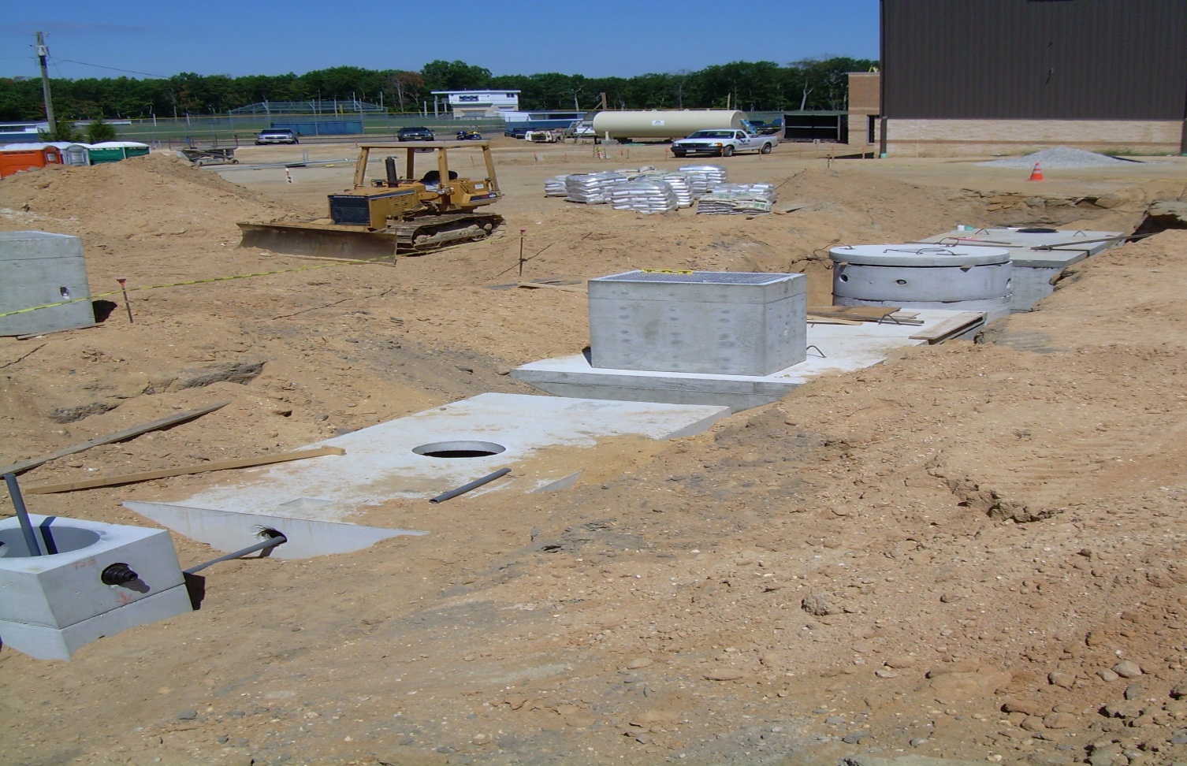
Installation

Slide 14
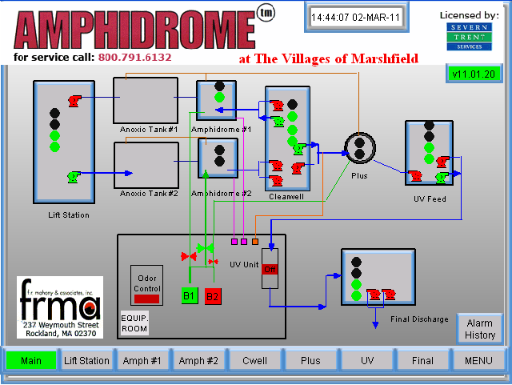
Controls
OPERATOR INTERFACE
AND
CONTROL

Slide 15
Main Touch Screen Display
Indicates current operation status of various equipment.
Provides access to individual component screens.
Simply touch on the item you wish to see.

Slide 16
Component Screen Display
Component status screen shows the status of specific equipment.
Provides access to control screens.
Component process controls easily accessed.
On-screen help.

Slide 17
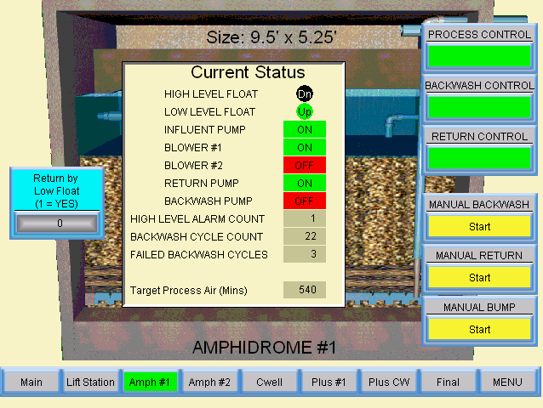
Component Screen Display

Slide 18
Troubleshooting Screen

Slide 19
Aeration Control
Process Air - air required for oxidation of organics and ammonia
Adjusts automatically to flow
Operator is only has to be concerned with one adjustment, the Aeration Factor (AF)

Slide 20
Process Air Control Screen

Slide 21
Remote Access
Remote Access and Control
Web access to plant via the internet
Remote monitoring of system
Remote Control of system
Access to touch screen as if standing in front of it.

Slide 22
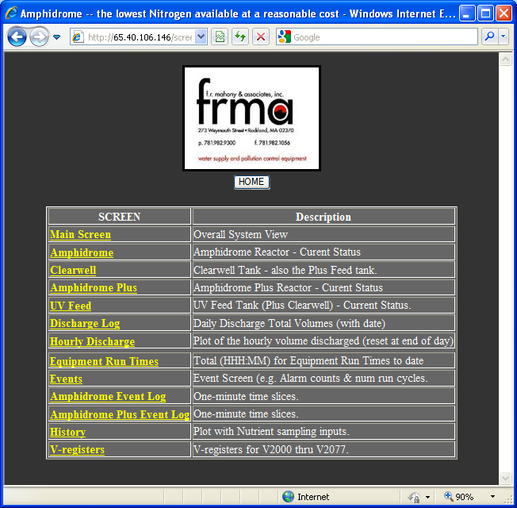
Remote Access

